Slide 1
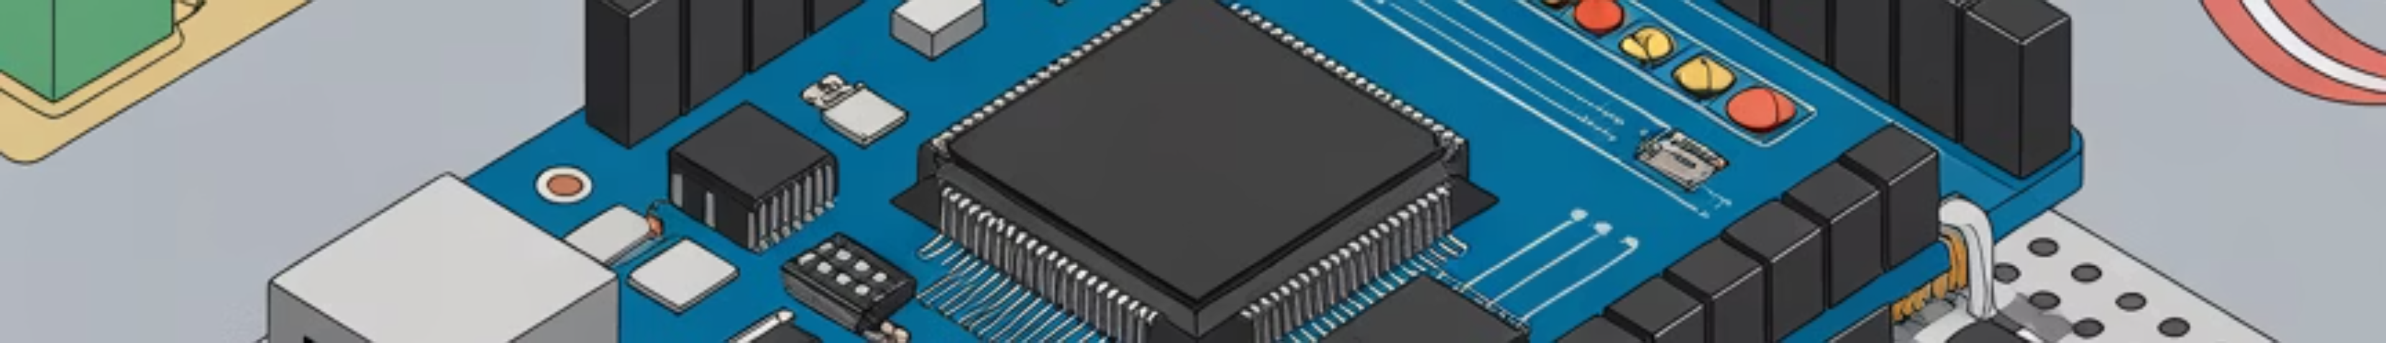
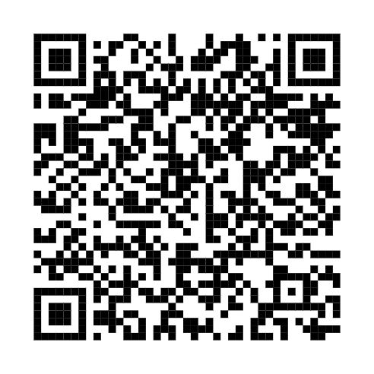
Wire We Doing This?
Building IoT Systems from Scratch
F-Con 2025

Slide 2



Meet Your Presenters
John Owen
Ajay Patel
Director, Security & Data Analytics
Senior Security Consultant
Fulcrum Technology Solutions
Fulcrum Technology Solutions

Slide 3
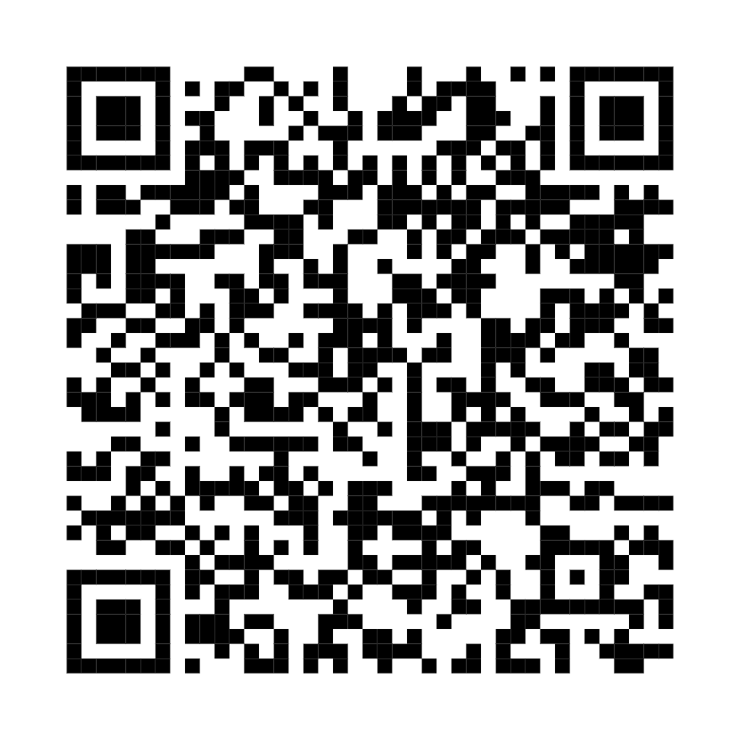

What You Need: Software Setup
Before we dive into building, let's get our software tools ready. You'll need the Arduino IDE to write and upload code to your board, and access to our GitHub repository for all the project files.
Install Arduino IDE
Download and install the latest version of the Arduino IDE for your operating system. This software is essential for writing and uploading code to your Arduino board. Follow the on-screen instructions for a smooth installation.
https://www.arduino.cc/en/software/
Access the Code
All the code, diagrams, and additional resources for today's workshop are available on our dedicated GitHub repository. You can clone or download the files from here:
github.com/Fulcrum-Technology-Solutions/fcon_2025_iotoys

Slide 4
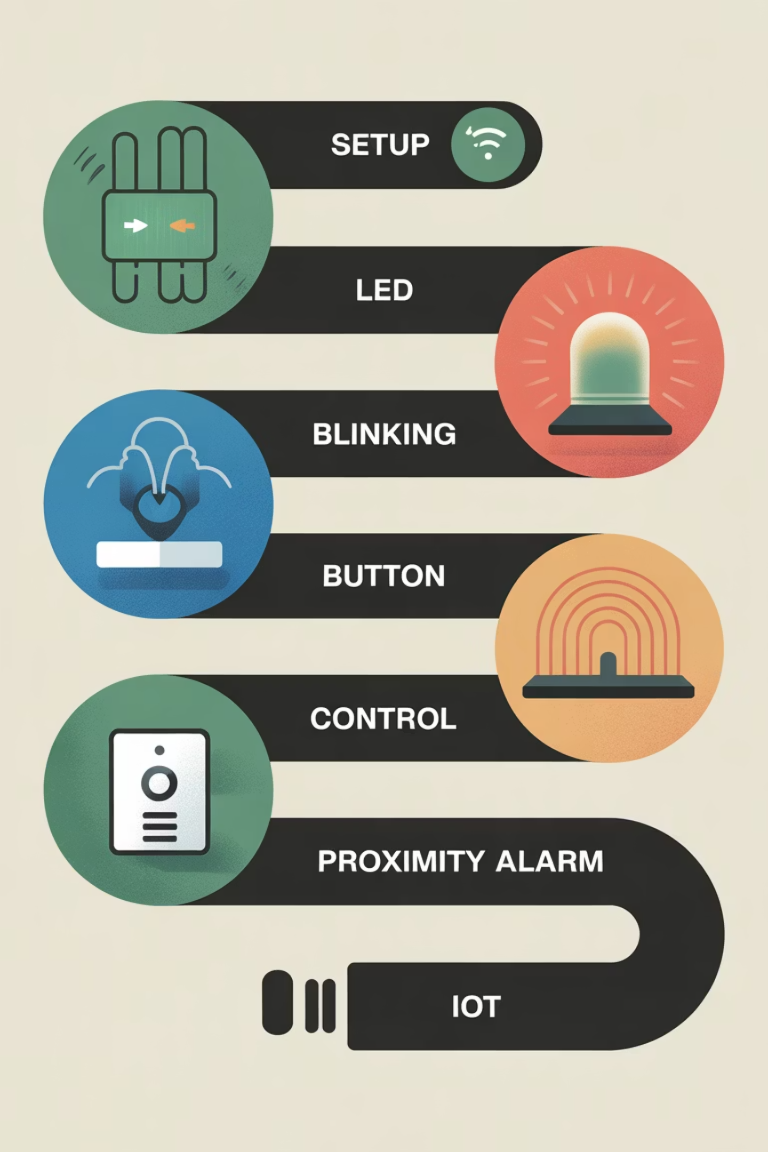
Today's Journey
What We're Building:
Phase 0: Power test & connectivity (Setup)
Phase 1: Blink an LED (Crawl)
Phase 2: Button control with feedback (Walk)
Phase 3: Distance-sensing proximity alarm (CHAOS)
The Goal: Understand how sensors, processors, and outputs work together to create IoT systems

Slide 5

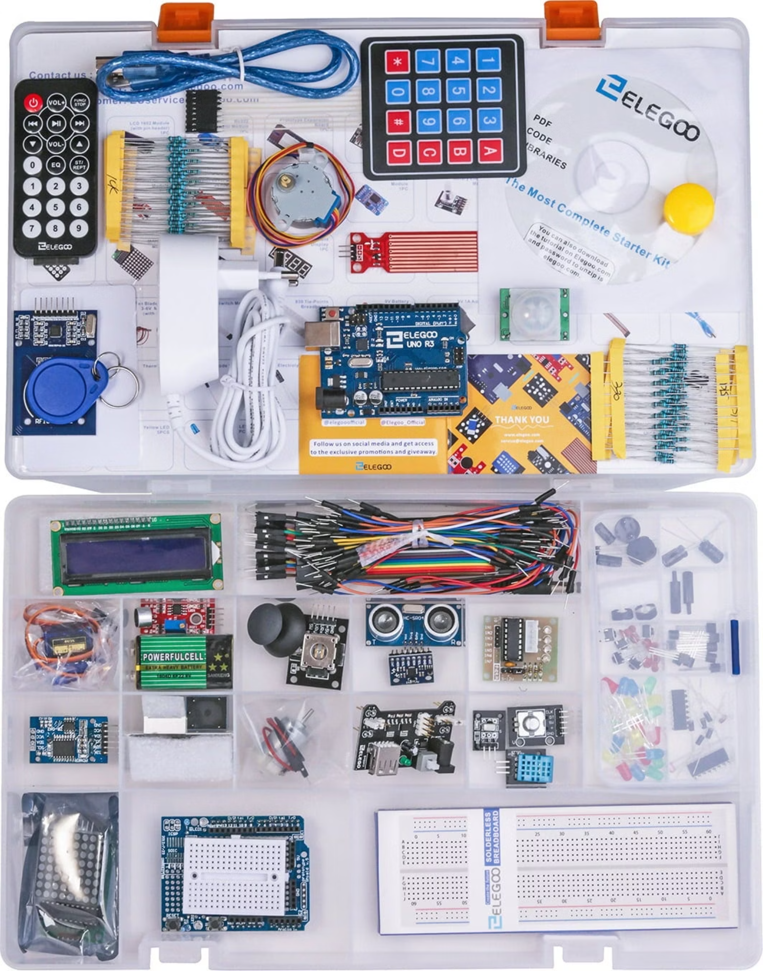
What's In Your Kit?
Key Components We're Using Today:
Arduino Uno - Your programmable brain
HC-SR04 Ultrasonic Sensor - Distance measurement
Breadboard & Prototype Shield - Your workspace
4-Digit 7-Segment Display - Numerical readout
Power Supply Module - Clean 5V power distribution
74HC595 Shift Register - Efficient display control
Red LED - Visual output
Supporting cast: 220Ω resistors, jumper wires
Active Buzzer - Audio alerts
Push Button - User input
… and much more!

Slide 6
Arduino 101
What is Arduino?
Why Arduino?
A microcontroller board that:
Easy to learn
Reads inputs (buttons, sensors, signals)
Massive community support
Processes information (runs your code)
Powers everything from hobby projects to commercial products
Controls outputs (lights, displays, buzzers)

Slide 7



The IoT Building Block Concept
SENSOR
PROCESSOR
OUTPUT
Gather information (distance, temperature, motion)
Make decisions (Arduino analyzes the data)
Take action (displays, buzzers, lights)
Every IoT device follows this pattern. Today you'll build increasingly complex systems using this exact pattern.

Slide 8

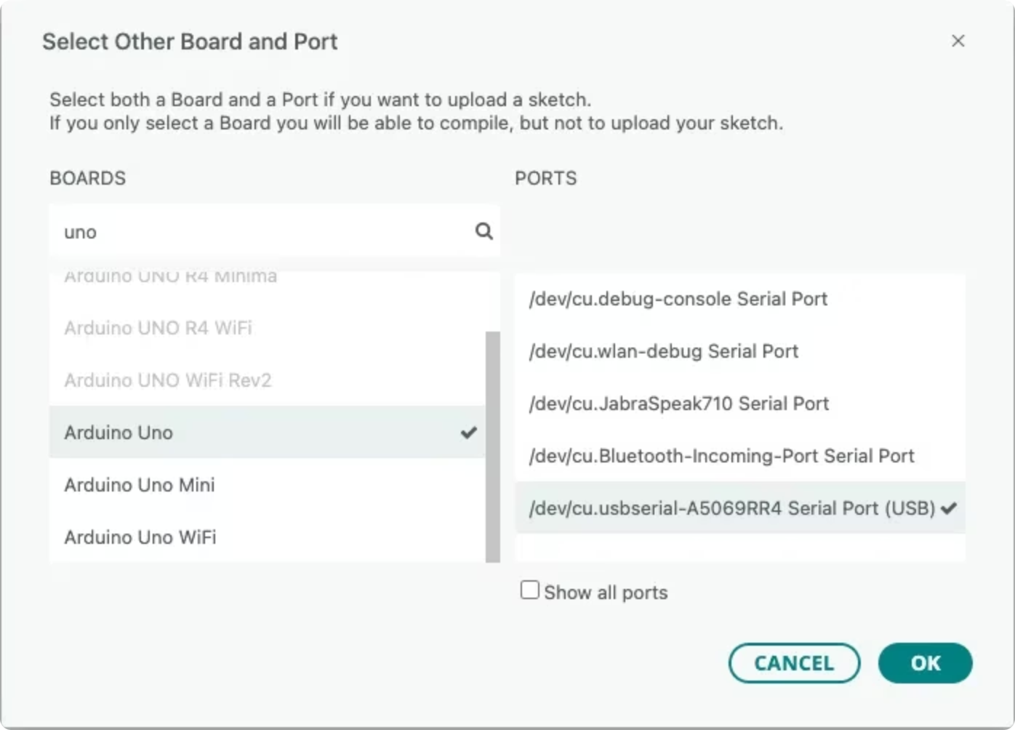

Setup Check: Arduino IDE
01
Install Arduino IDE
Download the latest version for your OS and follow the standard installation process.
02
Connect Uno R3
Plug your Arduino board into your computer with the USB A-to-B cable. Drivers should install automatically.
03
Configure Board & Port
In the IDE, go to Tools → Board → Arduino AVR Boards → Arduino Uno and then Tools → Port to select your Arduino's serial port.
If the upload fails, double-check your board and port selections. The Uno R3 is designed for easy setup!

Slide 9

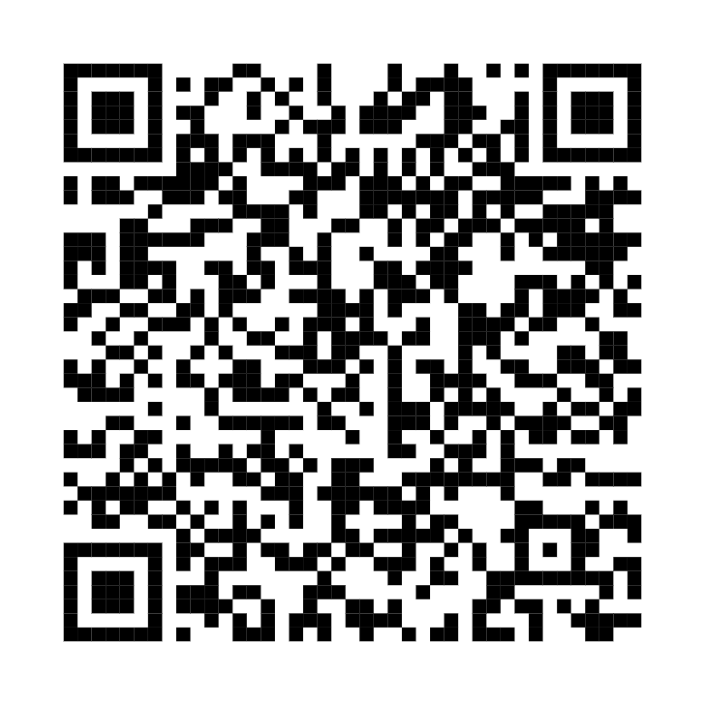

Setup Check
Before We Start:
Kit contents verified
Arduino IDE installed and open
Arduino connected via USB
GitHub repository link ready
ALL THE WIRES
GitHub Resources: https://tinyurl.com/5fan5erw All code, wiring diagrams, and troubleshooting guides
https://github.com/Fulcrum-Technology-Solutions/fcon_2025_iotoys

Slide 10
Phase 0 - Power Test (Setup)
Goal:
Verify everything is connected and powered correctly
Why This Matters:
What You're Learning:
A solid power foundation prevents 90% of problems!
Breadboard power distribution
Arduino connectivity
Serial communication basics

Slide 11
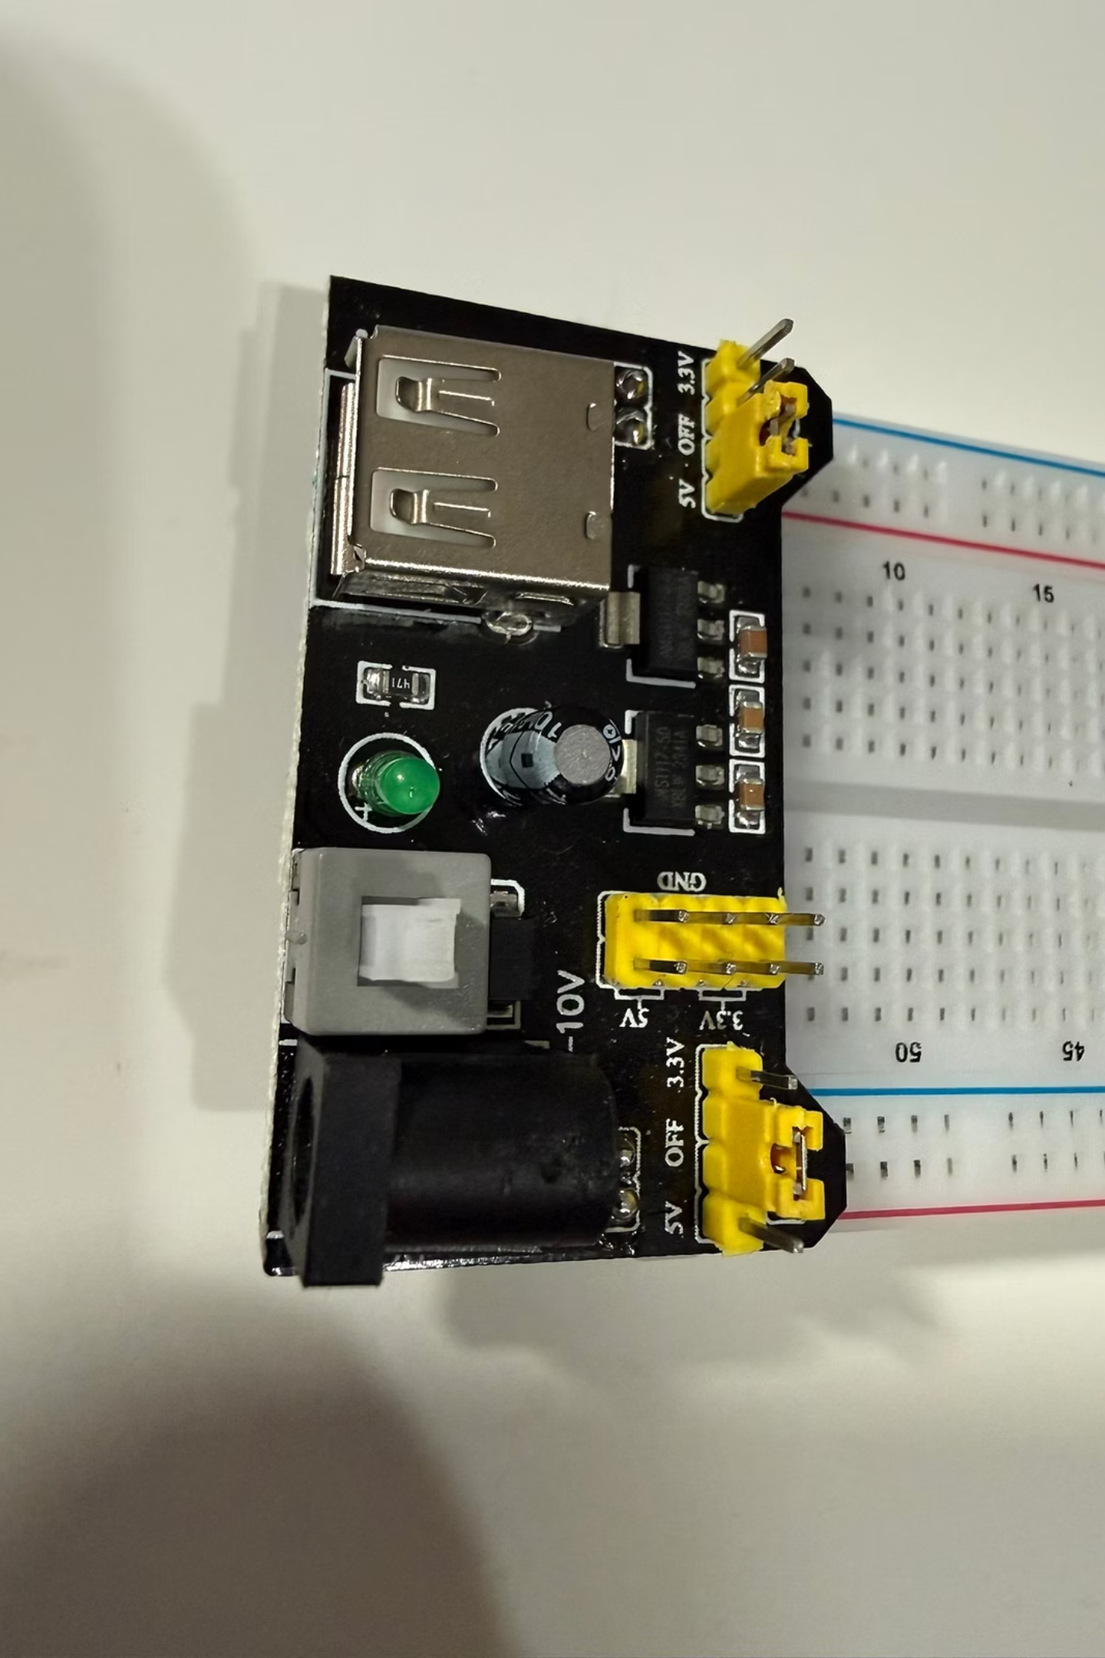

CRITICAL STEP: Set Power Jumper!
Before powering up your breadboard, ensure your power supply module's jumper cap is set to 5V.
The default is often 3.3V, but our components today require 5V for optimal performance and to avoid unexpected issues. Check for the small jumper cap on your power supply module and move it to the 5V position if it isn't already there.

Slide 12

Phase 0 - Let's Build
Steps:
Connect power supply module to breadboard rails
Connect Arduino 5V to breadboard top rail
Connect Arduino GND to breadboard ground rail
Open Phase 0 code from GitHub
Upload and open Serial Monitor (9600 baud)
Verify "System Status: READY" messages
Success: You should see power verification messages every 2 seconds

Slide 13
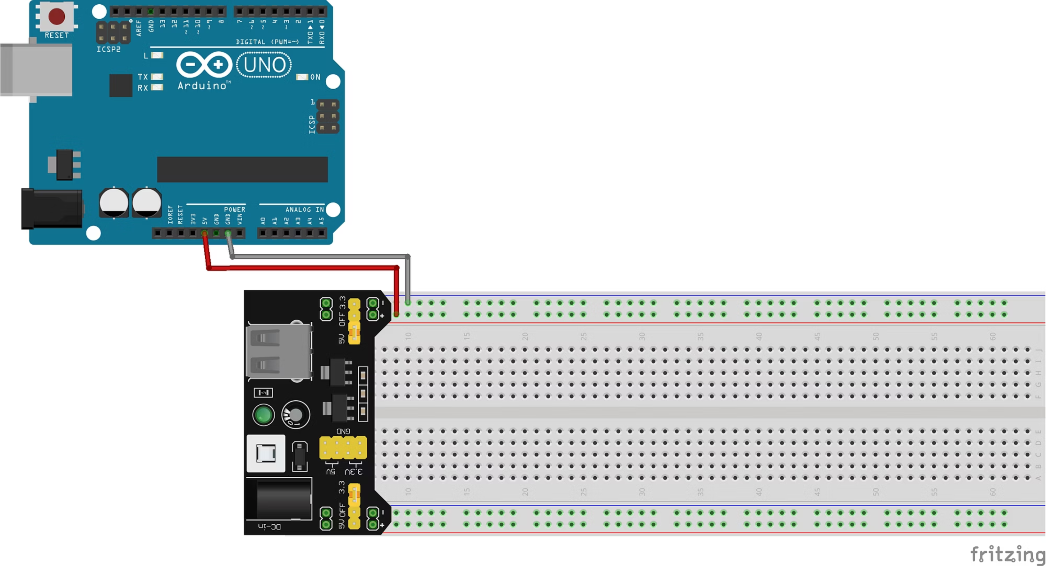
*wire colors in the diagrams are for visual reference only - general guidance = use the shortest wire that works

Slide 14

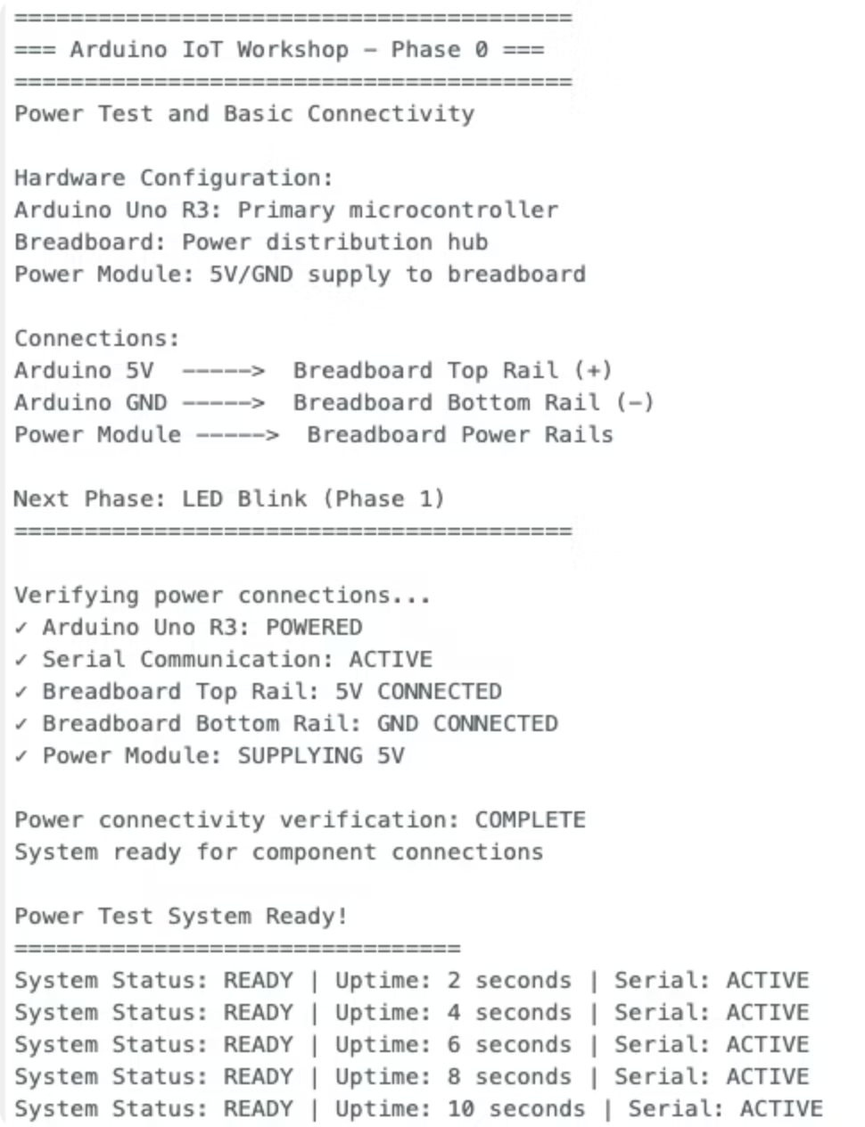

Phase 0 - Let's Build
Steps:
1
Connect power supply module to breadboard rails
2
Connect Arduino 5V to breadboard top rail
3
Connect Arduino GND to breadboard ground rail
4
Copy Phase 0 code from GitHub
5
Upload and open Serial Monitor (9600 baud)
6
Verify "System Status: READY" messages
Success: You should see power verification messages every 2 seconds

Slide 15
Phase 1 - First Light (Crawl)
Goal:
Real-World Applications:
Make an LED blink
Smart home lighting
Notification systems
What You're Learning:
Status indicators
Basic circuit building
Digital pin control (Pin 13)
Non-blocking timing with millis()

Slide 16
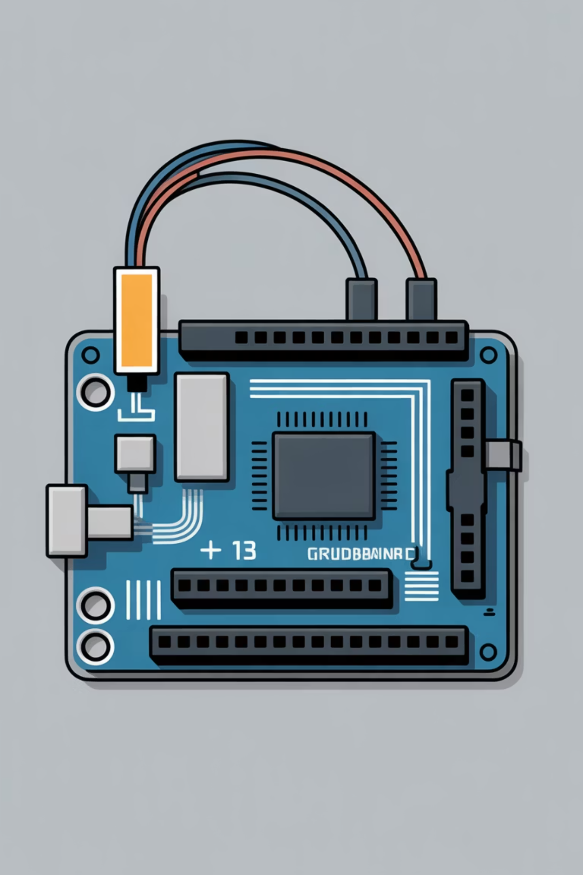
Phase 1 - Components
What You Need:
The Circuit:
1x Red LED
Pin 13 → LED positive (long leg)
Jumper wires
LED negative → Ground rail (direct connection, no resistor needed)
Breadboard (already powered from Phase 0)

Slide 17
Phase 1 - Let's Build
Steps:
1
Insert LED into breadboard
2
Connect Pin 13 to LED positive lead
3
Connect LED negative to ground rail
4
Open Phase 1 code from GitHub
5
Upload to Arduino
6
Watch it blink! (500ms on, 500ms off)
Serial Monitor: Shows LED state changes with timestamps

Slide 18
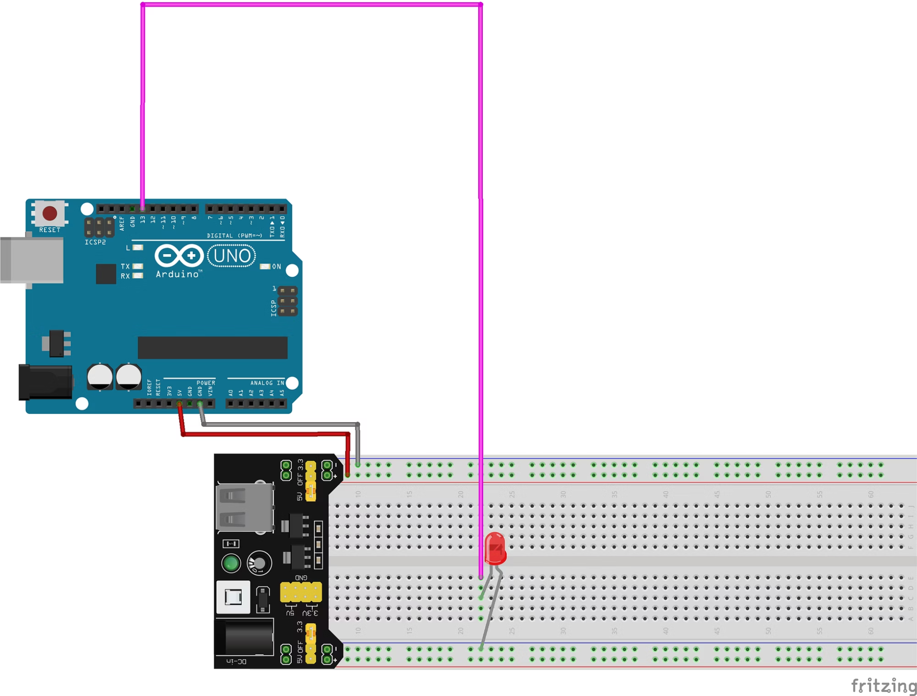
What You Need:
1x Red LED
Jumper wires
Breadboard (already powered from Phase 0)
The Circuit:
Pin 13 → LED positive (long leg)
LED negative → Ground rail (direct connection, no resistor needed)

Slide 19

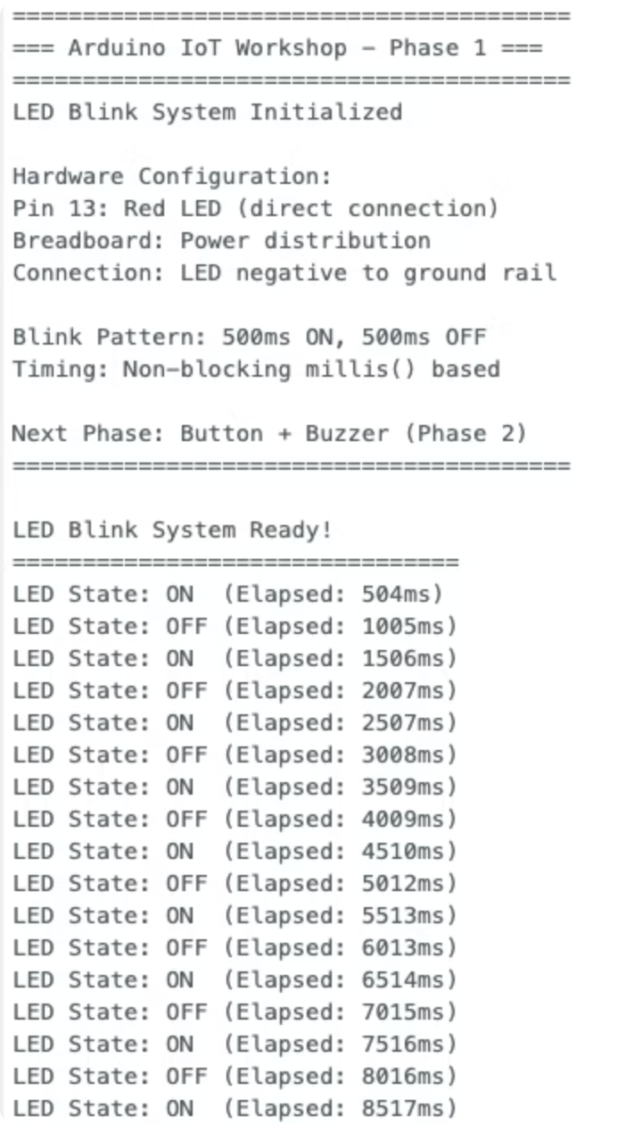
Phase 1 - Let's Build
Steps:
1
Insert LED into breadboard
2
Connect Pin 13 to LED positive lead
3
Connect LED negative to ground rail
4
Open Phase 1 code from GitHub
5
Upload to Arduino
6
Watch it blink! (500ms on,
500ms off)
Serial Monitor: Shows LED state changes with timestamps

Slide 20
Phase 2 - Button Control (Walk)
Goal:
Real-World Applications:
Button toggles LED on/off with buzzer feedback
Light switches
Alarm systems with user control
What You're Learning:
Interactive devices
Reading digital inputs (buttons)
INPUT_PULLUP resistor configuration
Controlling multiple outputs
State management

Slide 21

Phase 2 - Components
What You Need:
New Connections:
Red LED (from Phase 1 - keep it connected!)
Pin 7 → Buzzer positive
1x Push Button
Buzzer negative → Ground
1x Active Buzzer
Pin 8 → Button terminal
Jumper wires
Button other terminal → Ground

Slide 22
Phase 2 - Let's Build
Steps:
1
2
3
Keep Phase 1 LED connected
Add button between Pin 8 and ground
Add buzzer between Pin 7 and ground
4
5
Copy Phase 2 code from GitHub
Upload and test!
Expected Behavior:
Press button → LED toggles + buzzer beeps
Press again → LED toggles opposite way + beep

Slide 23
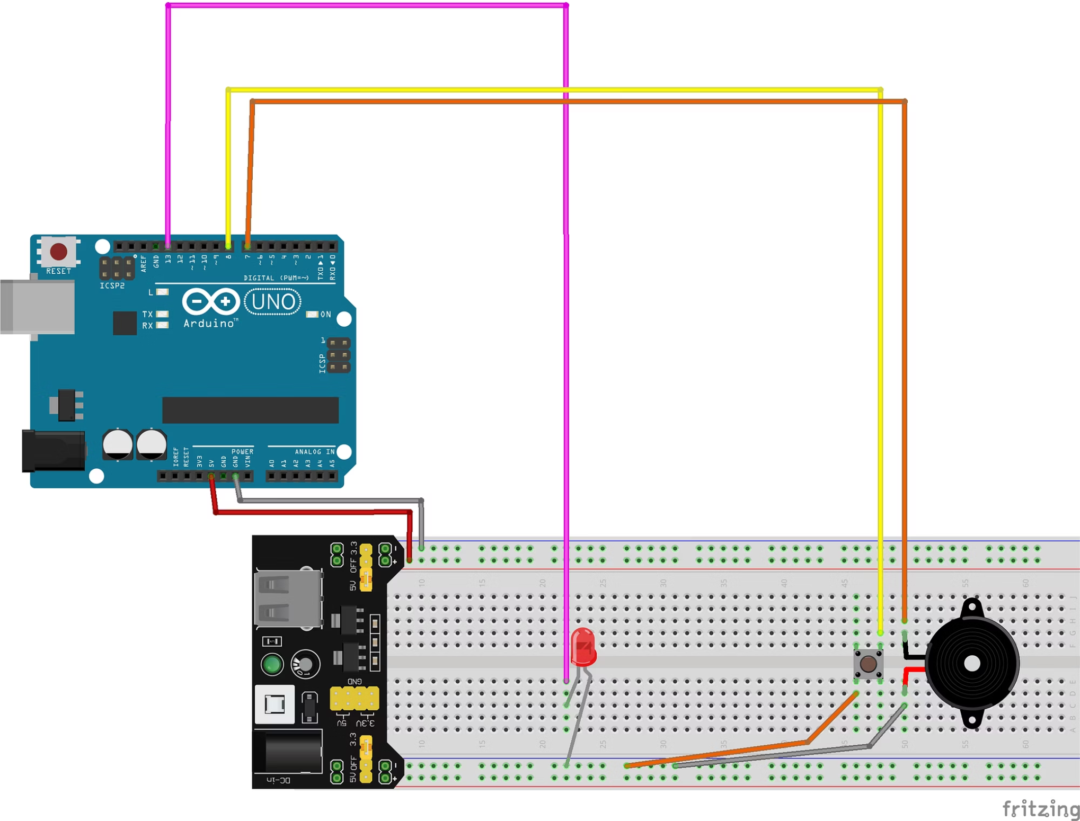
What You Need:
Green LED (from Phase 1 - keep it connected!)
1x Push Button
1x Active Buzzer
Jumper wires
New Connections:
Pin 7 → Buzzer positive
Buzzer negative → Ground
Pin 8 → Button terminal
Button other terminal → Ground

Slide 24

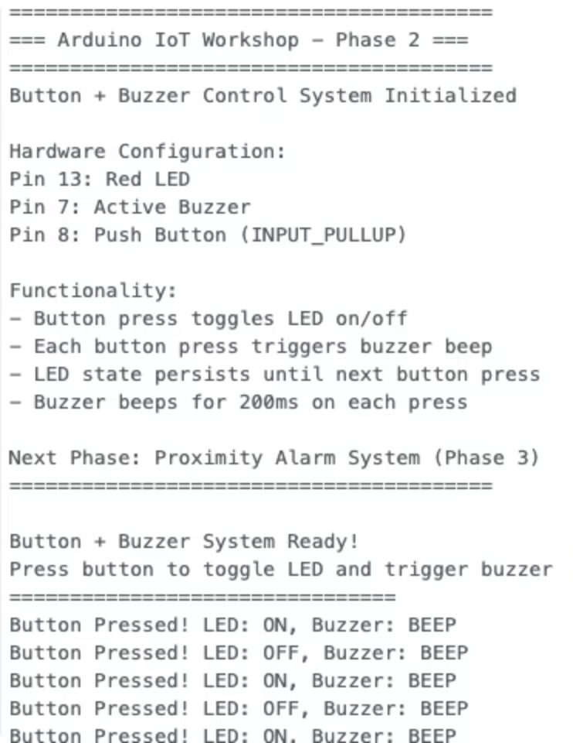
Phase 2 - Let's Build
Steps:
1
2
Keep Phase 1 LED connected
Add button between Pin 8 and ground
3
4
Add buzzer between Pin 7 and ground
Open Phase 2 code from GitHub
5
Upload and test!
Expected Behavior:
Press button → LED toggles + buzzer beeps
Press again → LED toggles opposite way + beep

Slide 25
Phase 3 - Proximity Alarm (CHAOS)
Goal:
Real-World Applications:
Distance-sensing alarm system that beeps faster as objects approach
Car parking sensors (backup alarms)
Security/intrusion detection
Automated door systems
What You're Learning:
Ultrasonic distance measurement
Shift register control for displays
Display multiplexing
Variable alarm behavior based on sensor input
Complete system integration

Slide 26
Phase 3 - The Complete System
This is a FULL IoT system with:
Input:
Processing:
Outputs:
Ultrasonic sensor measures distance (2-400cm)
Arduino calculates beep rate based on distance
4-digit display shows distance in cm
LED lights at ≤5cm
Buzzer beeps at ≤10cm (faster as distance decreases)
Mute button for buzzer control

Slide 27
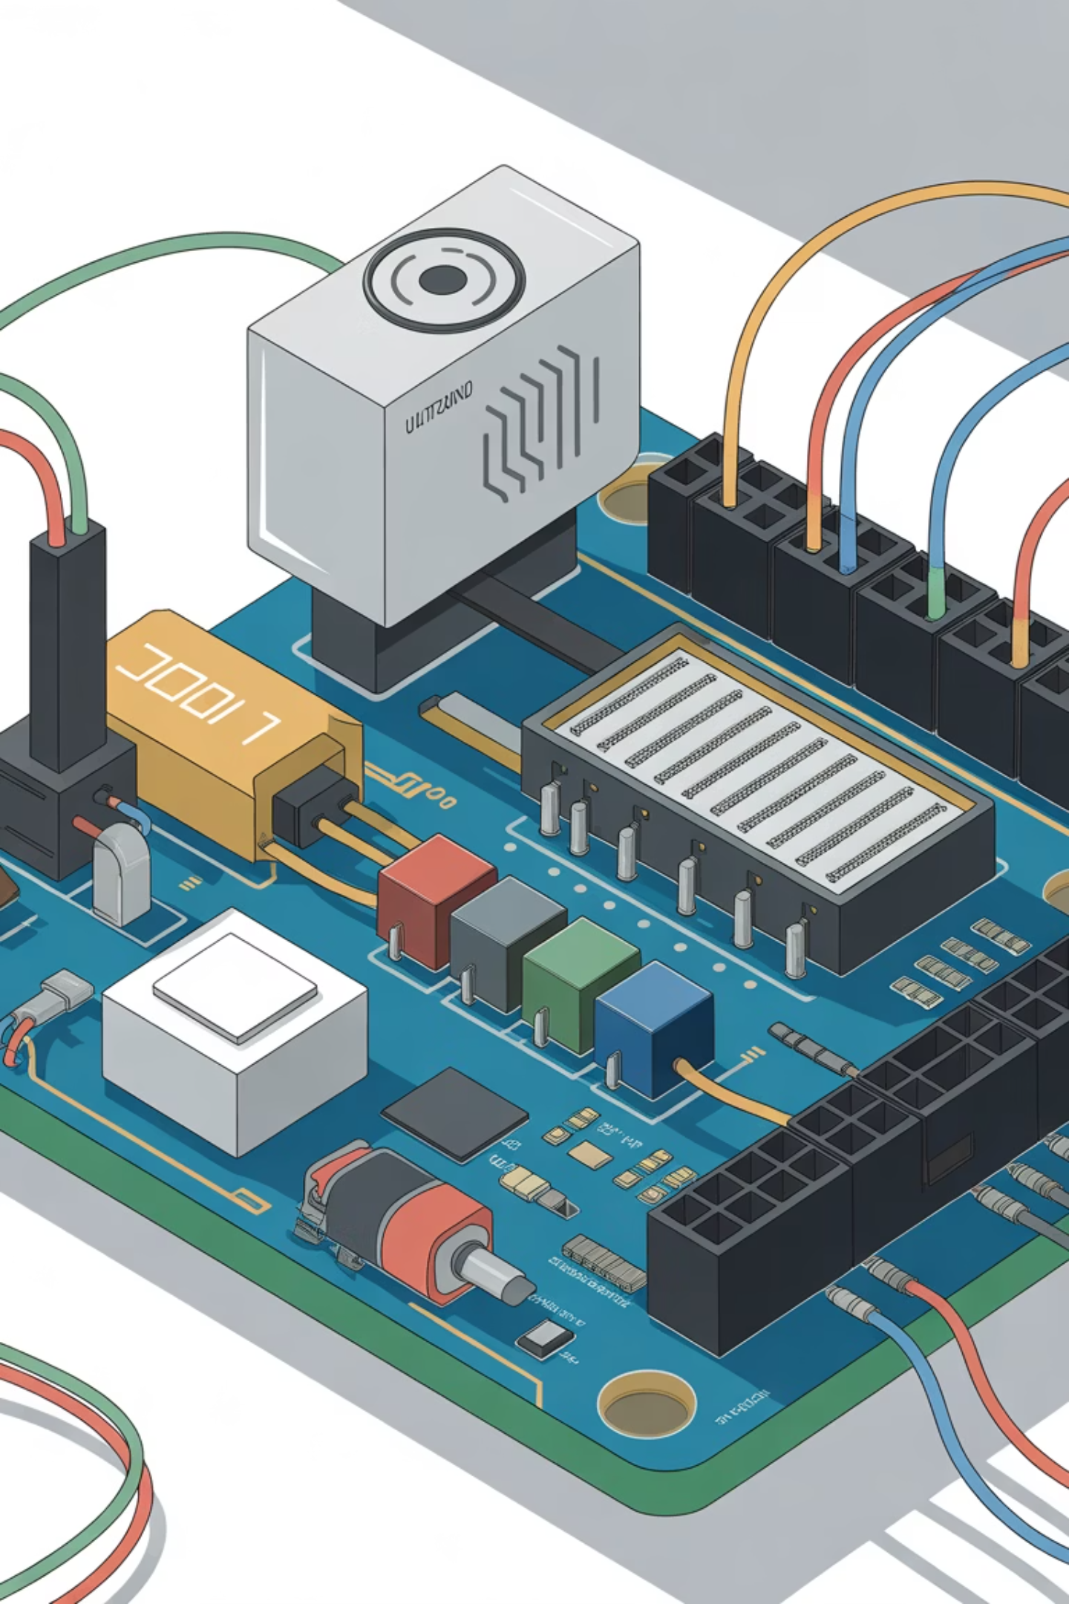
Phase 3 - Components
What You Need:
HC-SR04 Ultrasonic Sensor
4-Digit 7-Segment Display
74HC595 Shift Register (may be built into display)
Complex Wiring: This is the most involved - take your time!
LED, Buzzer, Button (from Phase 2 - keep connected!)
Multiple jumper wires

Slide 28
Phase 3 - Critical Connections
Shift Register & Display:
Pin 4 → Data
Pin 5 → Latch
Pin 6 → Clock
Pins 9-12 → Display common cathodes
Keep Phase 2 components: Pin 7 (buzzer), Pin 8 (button), Pin 13 (LED)
Ultrasonic Sensor:
Pin 2 → TRIG
Pin 3 → ECHO
VCC → 5V rail
GND → Ground rail

Slide 29
Phase 3 - Let's Build
Steps:
1
2
3
Add 4-digit display with shift register connections
Add ultrasonic sensor (TRIG to Pin 2, ECHO to Pin 3)
Verify all Phase 2 components still connected
4
5
Copy Phase 3 code from GitHub
Upload and test!
Testing:
Move your hand toward/away from sensor
Display shows distance in cm
LED lights at ≤5cm
Buzzer beeps at ≤10cm (faster = closer)
Button mutes/unmutes buzzer

Slide 30
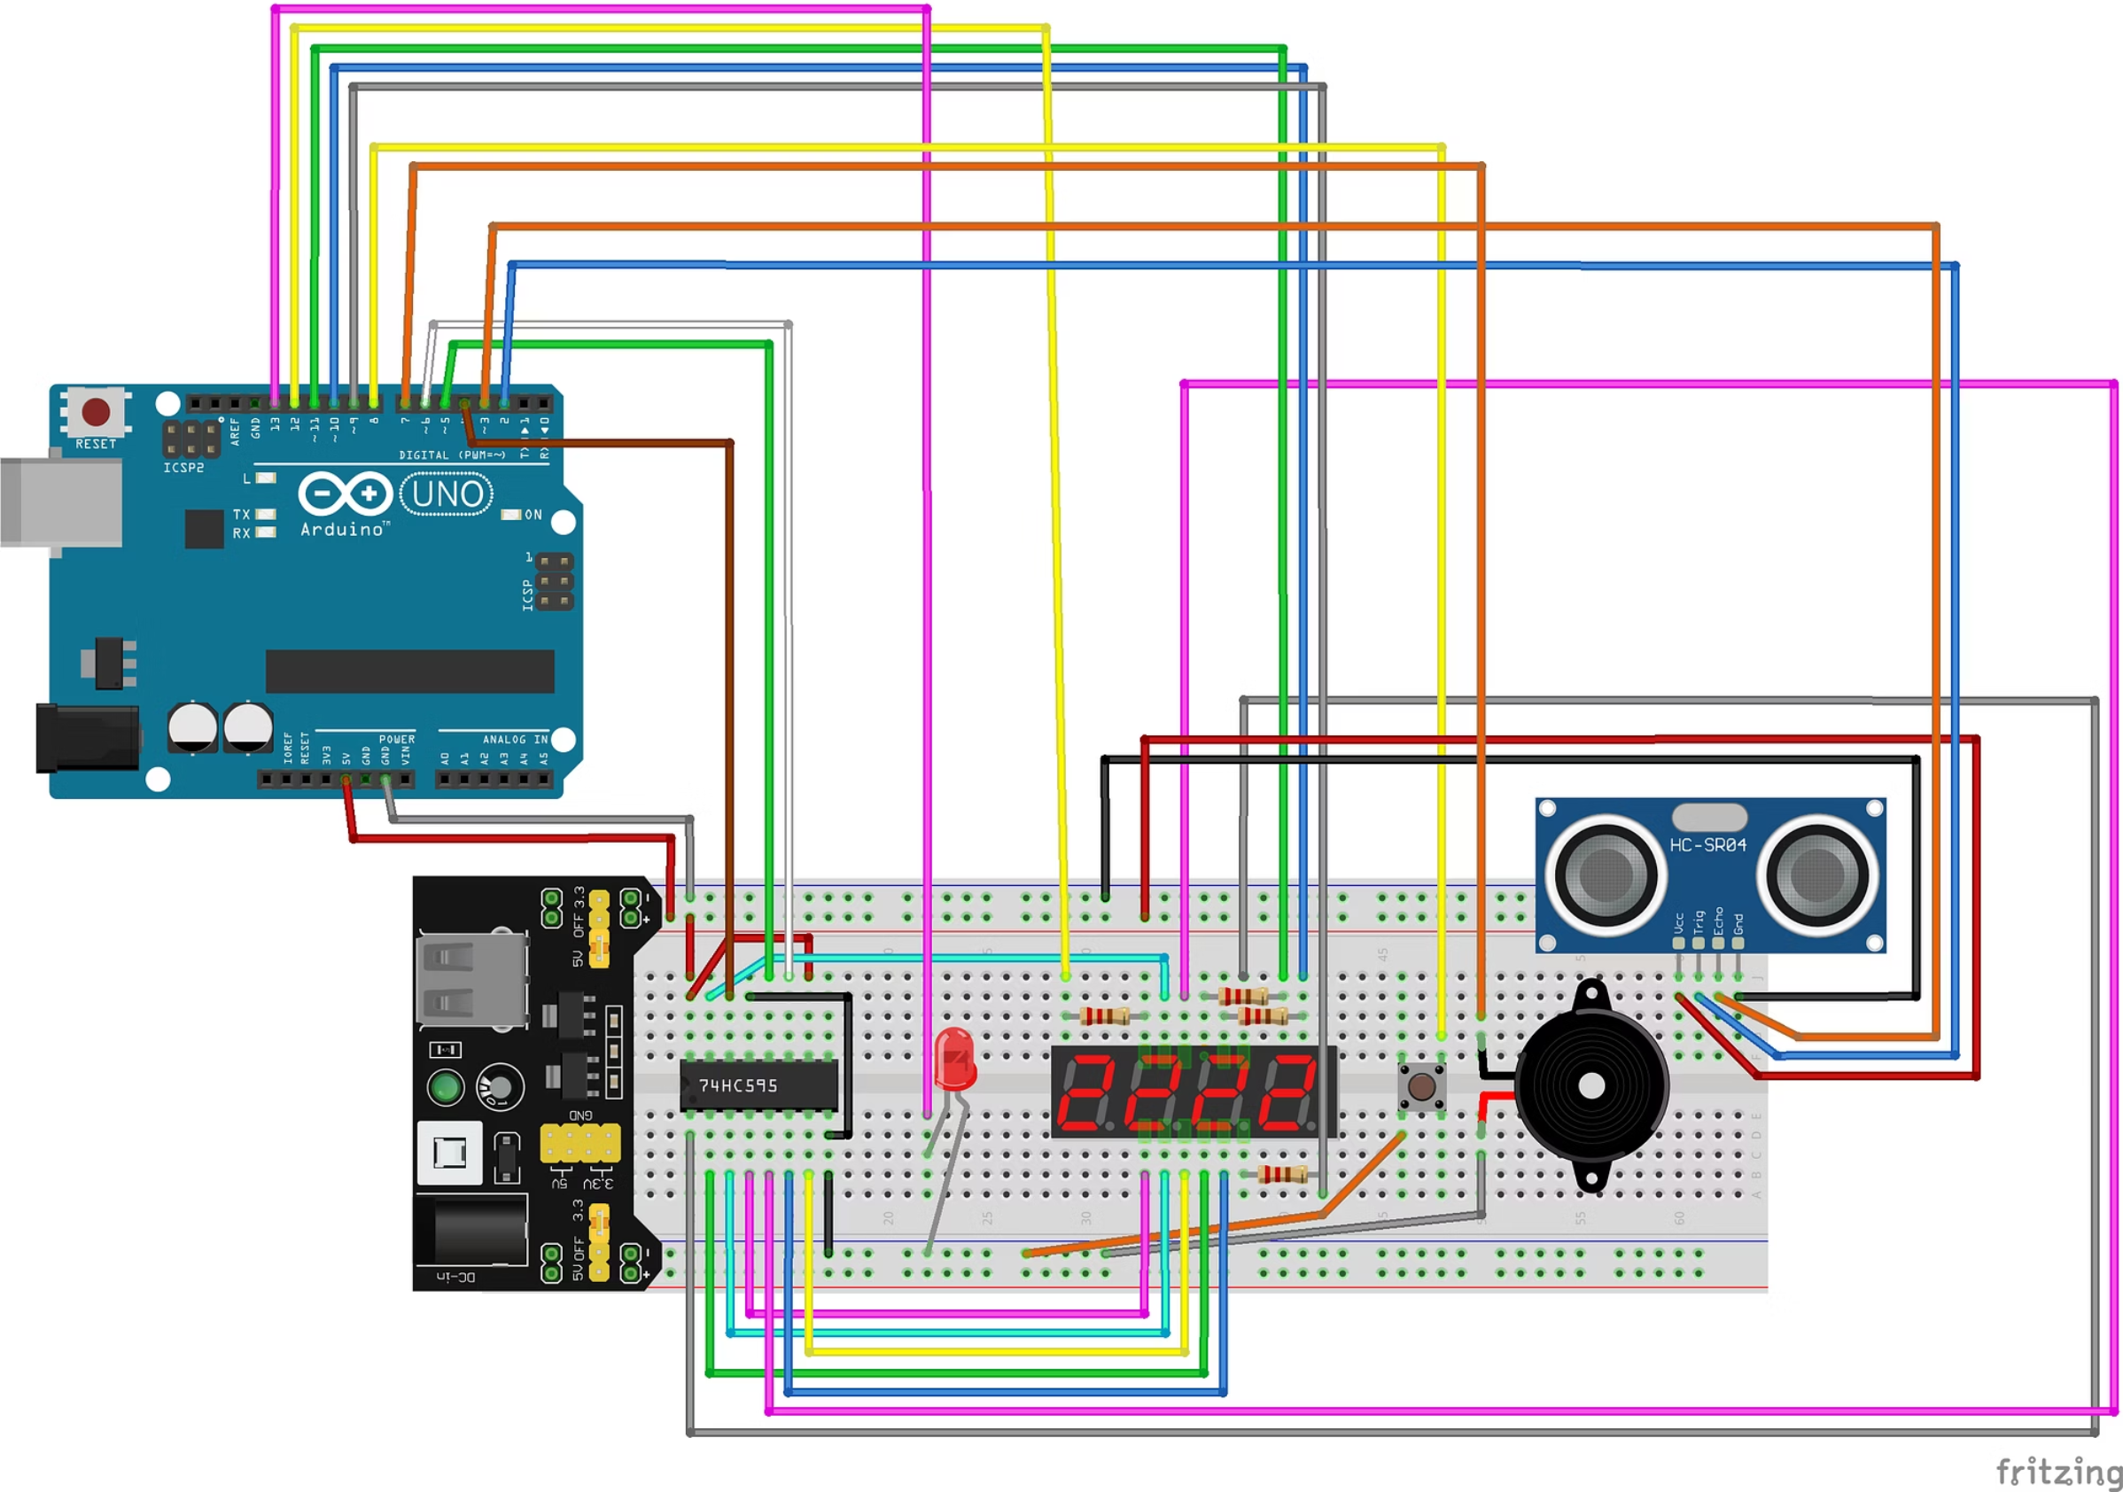

Slide 31


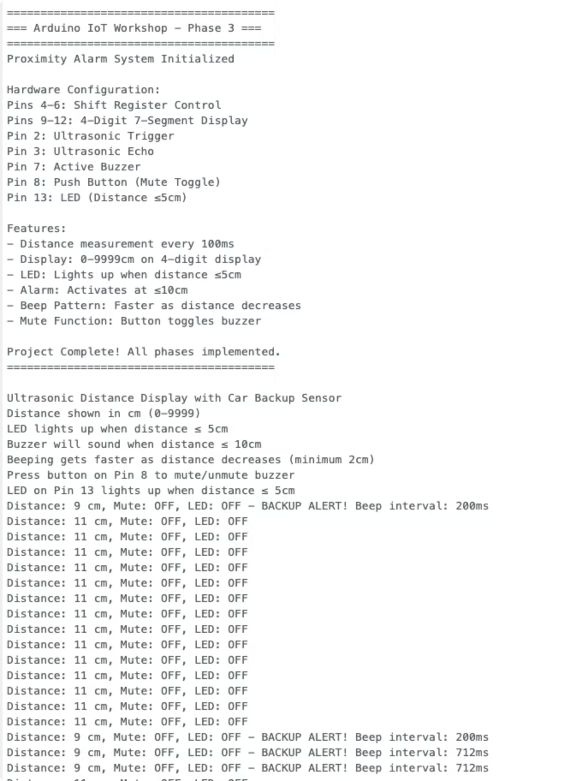
Phase 3 - Let's Build
Steps:
1
2
Add 4-digit display with shift register connections
Add ultrasonic sensor (TRIG to Pin 2, ECHO to Pin 3)
3
4
Verify all Phase 2 components still connected
Copy Phase 3 code from GitHub
5
Upload and test!
Testing:
Move your hand toward/away from sensor
Display shows distance in cm
LED lights at ≤5cm
Buzzer beeps at ≤10cm (faster = closer)
Button mutes/unmutes buzzer

Slide 32
Quick Check
Phase 3 Status Check:
👍 Working?
🤔 Still building?
❌ Having issues?
Experiment with different distances!
Keep going - this is the complex one!
Common problems in troubleshooting guide
Everyone's at different stages - that's completely normal!

Slide 33


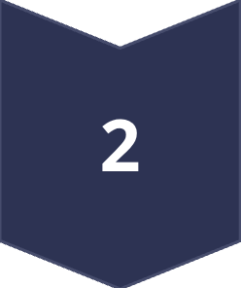
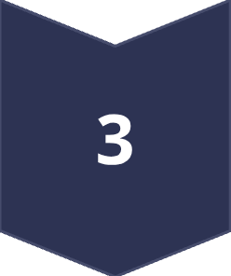
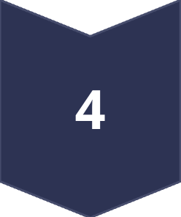
What You Built Today
Four Progressive Systems:
Power verification - Foundation for everything
Simple output control - LED blinking (processor → output)
Interactive control - Button input with multiple outputs (input → processor → outputs)
Autonomous sensor system - Distance-based alarm with display (sensor → processor → multiple outputs)
The Evolution: From simple blink to complete IoT automation!

Slide 34

The Building Block Approach
Phase 1:
Phase 2:
Phase 3:
OUTPUT only (LED)
INPUT + OUTPUTS (button → LED + buzzer)
SENSOR + PROCESSING + MULTIPLE OUTPUTS (ultrasonic → Arduino logic → display + LED + buzzer)
This is how ALL IoT systems work
- just different combinations of these same building blocks!

Slide 35
The Flexibility of Arduino
Same Arduino, Endless Possibilities:
Home automation systems
Weather stations
Your kit has even more: Temperature sensors, servo motors, LCD display, IR receiver, relay...
Robots and drones
Art installations
Wearable tech
Industrial monitoring

Slide 36
Resources & Next Steps
GitHub Repository:
Keep Learning:
https://tinyurl.com/5fan5erw
Arduino official tutorials (arduino.cc)
All Phase 0-3 code
Online communities (Arduino forums, Reddit r/arduino)
Wiring diagrams for each phase
Experiment with other components in your kit!
Component specifications
Detailed troubleshooting guide

Slide 37
Q&A / Troubleshooting
Questions?
About what we built today
Component functionality
Where to go next
Troubleshooting your Phase 3 build
Still working on Phase 3? Keep building - we're here to help!

Slide 38
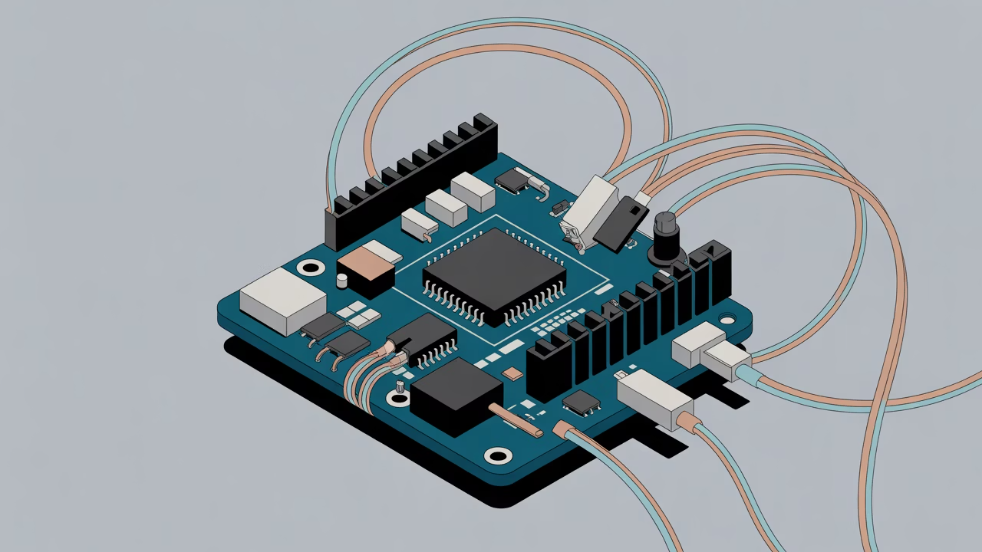
Wire We Doing This?
Thanks for building IoT systems with us today!
Resources: https://tinyurl.com/5fan5erw
Questions: jowen@ftsc.com apatel@ftsc.com
Happy tinkering! 🔧⚡

